Slide 1
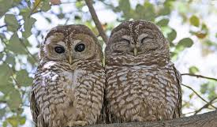
Lab 9: Owl Conservation and Home Range Size

Slide 2

Last week:
Rough drafts and peer review
Today:
Next week:
Upcoming:
Pre-lab 9
Pre-lab 10
Final attempt skills demos by Wk 10
Final drafts due – SELF EVAL!
Endangered species conservation – Spotted owls
Lichen succession
All outstanding work due
GIS and climate modeling
You are here!

Slide 3

Lab 9: Learning Outcomes
Use a dichotomous key to identify mammal bones.
Calculate maximum sustainable yield for populations.
Explain relationships between productivity, reproductive rate, population density, and territory size.
Make, defend, and evaluate estimates about behavior, populations, and productivity using valid information and assumptions.
Synthesize information about home range sizes, food web relationships and management to develop a habitat conservation strategy.

Slide 4
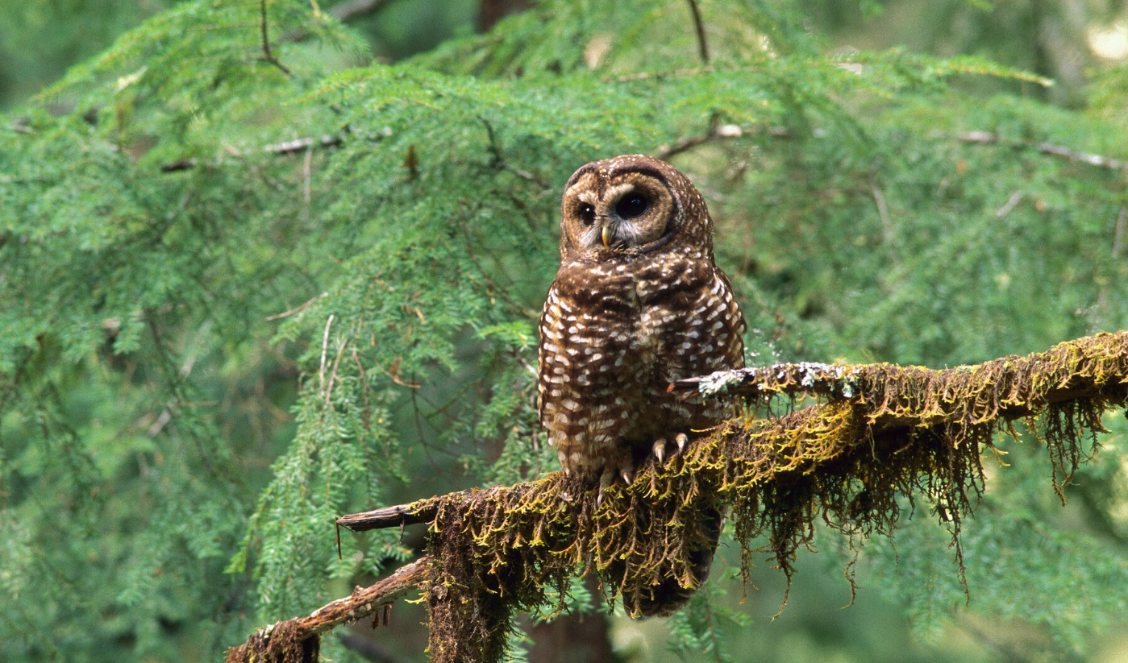
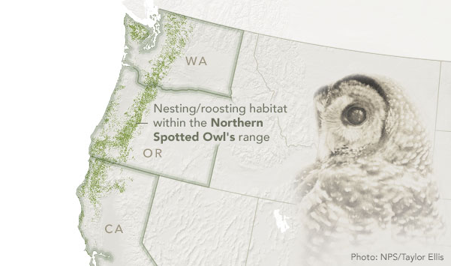
Case Study: The Northern Spotted-Owl
Life-History:
Nocturnal predators that prey upon small mammals
Individuals often mate for life and 2-3 eggs a year
Habitat
Old-growth forests that contain large hollow trees to nest in
Historical status and current trends
Their range has largely declined due to habitat loss, encroaching of other owls, more frequent forest fires, and timber
Notes:
Getting to know the spotted owl:
Historically, these owls lived in late successional or old-growth forests ranging from Southern British Colombia, to Northern San Francisco.
Individuals mate for life and produce multiple eggs between late winter and early Spring. The female will incubate the eggs while the male provides food for months at a time.
Owlets are able to perch on their own at about 3-4 weeks of age, but rarely survive due to predation from Great Horned Owls and other predatory birds. They live upon the help of mom and dad until they are around 6 months of age.

Slide 5
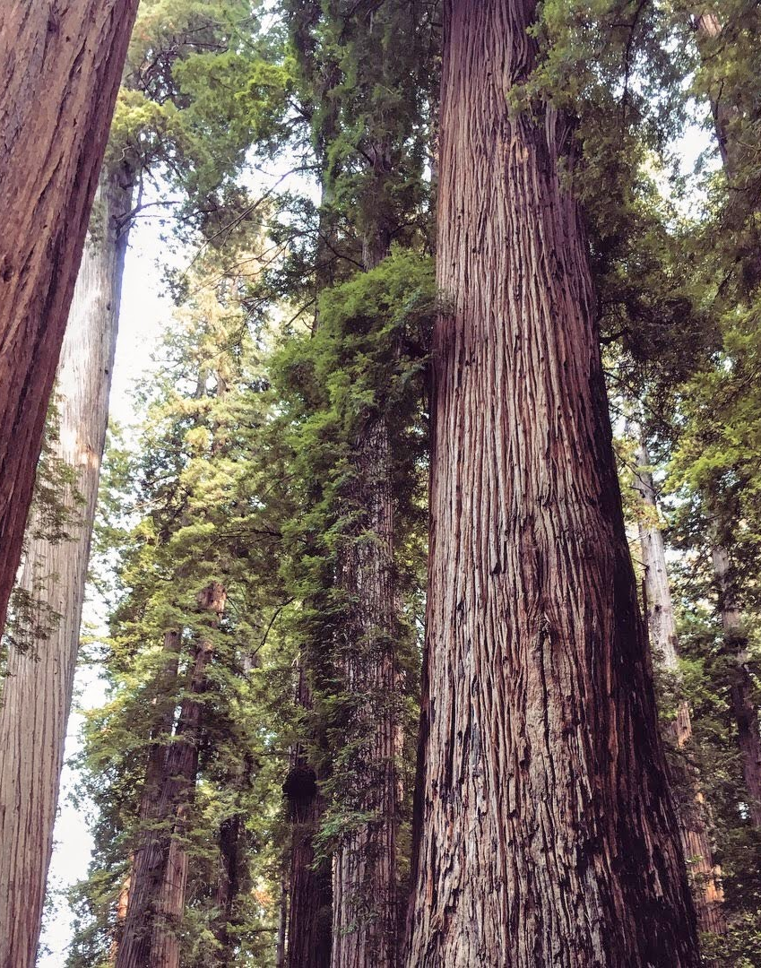
Old-Growth Forests of the PNW
A forest late in succession
Disturbances have not occurred in centuries
Often contain trees that are sometimes thousands of years old, and ecosystems as diverse as coral reefs that hang hundreds of feet in the air
But their importance has not always been recognized by local communities or even scientists

Slide 6
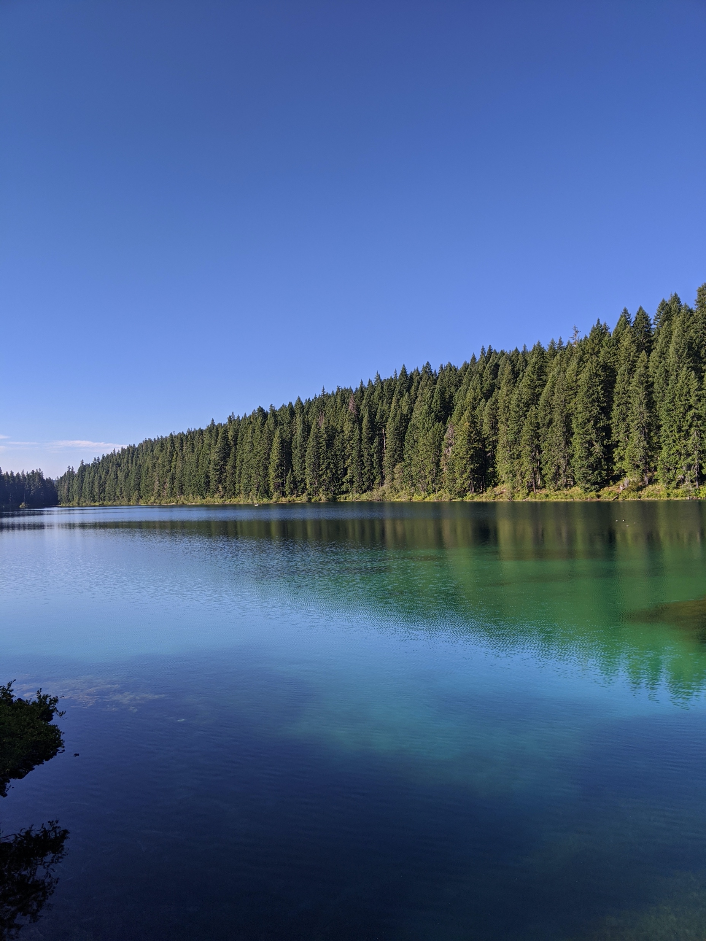
Up until the 1980’s no scientists or forest management acknowledged old-growth forest as important ecosystems
Known as “Cellulose cemeteries” wildlife biologists considered these areas to be dead zones
- This was largely because biologists and management organizations were funded by the fish and game department, or the the department of agriculture

Slide 7
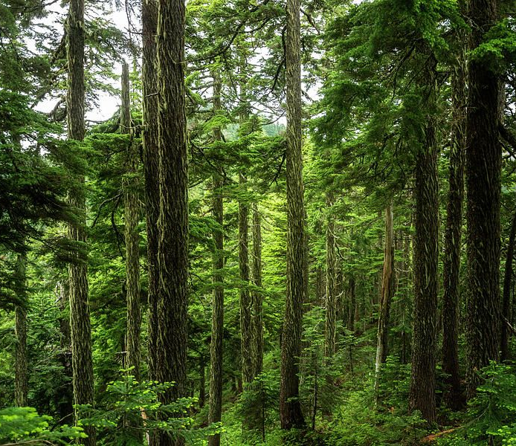
Whomever said money doesn’t grow on trees, didn’t consider the PNW
Oregon timber boomed after WW2
Gas powered chainsaws and log trucks
By the mid 80’s timber was the highest valued crop in the United States
Higher than both corn and cotton
Timber developed rural communities with roads, schools, and infrastructure needed for development

Slide 8
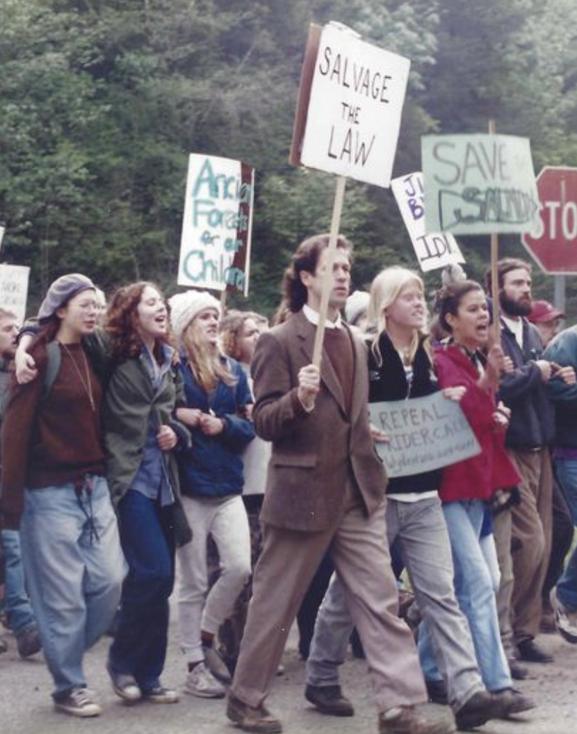
The stand against big timber
Multiple environmental groups recognized Big Timber as a major threat to the survival of Old-growth forests for multiple reasons
Lawsuits and court battles were sometimes successful, but only lead to small areas of large forests to be protected from logging
Endangered Species Act (1973) -> NW Forest Plan (1994 – ongoing)
Notes:
N. Spotted Owl listed as Threatened under ESA in 1990
NW Forest Plan still being used as a “balancing” agreement between management agencies
Rule-making and litigation ongoing

Slide 9
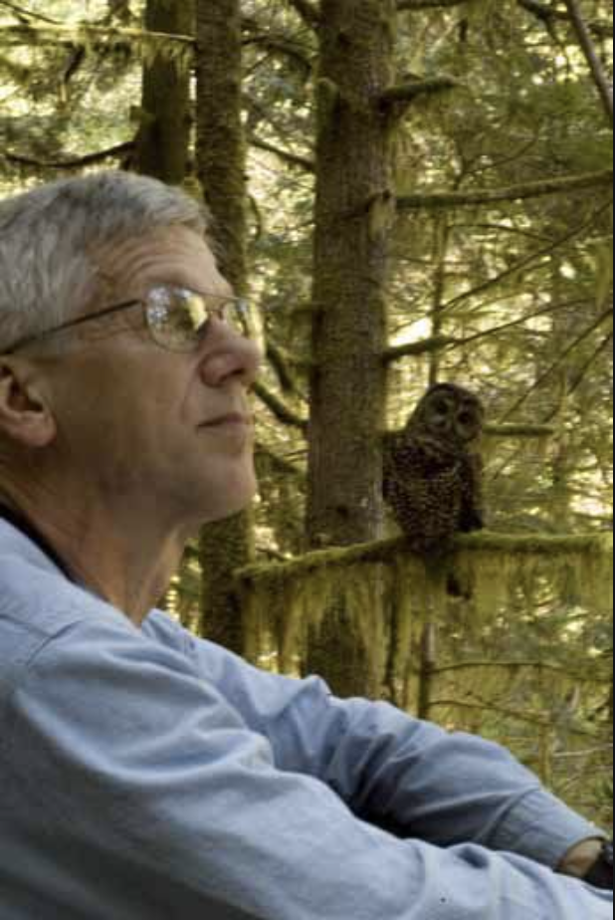
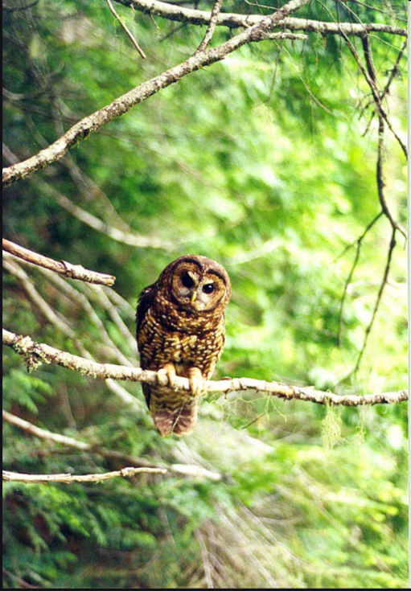
The Owl
Before the 1970’s, virtually nothing was known about the Northern Spotted Owl
Over the next two decades it would become one of the most researched birds in the US
After several years of dragging its feet, the US Fish and Wildlife Service finally listed the Northern Spotted Owl as threatened on June 22nd, 1990
While there was no specific law protecting Old Growth Forests, the endangered species act could now be used to protect the owl’s habitat
Eric Forsman -one of the first to study the spotted owl
Notes:
“Umbrella species” – flagship/charismatic species or keystone species whose protection creates protection of whole ecosystem. Other examples: Giant panda, Right whales

Slide 10
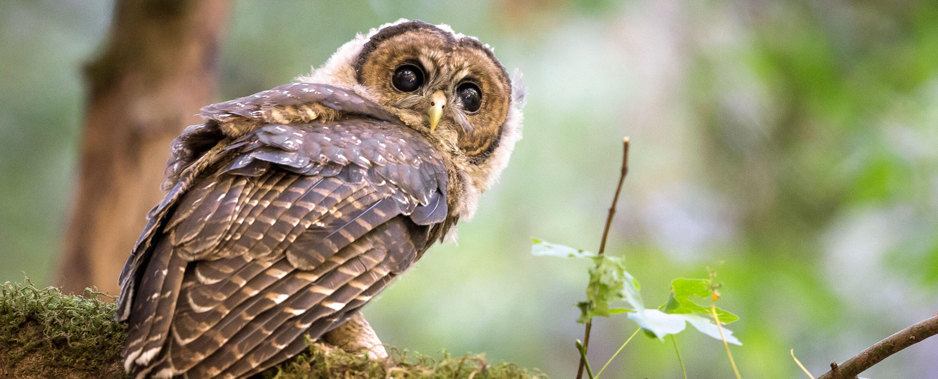
Group Discussion
Discuss with your group about why we should or should not protect the Northern Spotted Owl and put your remarks in the class google doc
Consider both sides of the argument, and who is affected on either side
Be considerate and respectful of each other’s perspectives

Slide 11
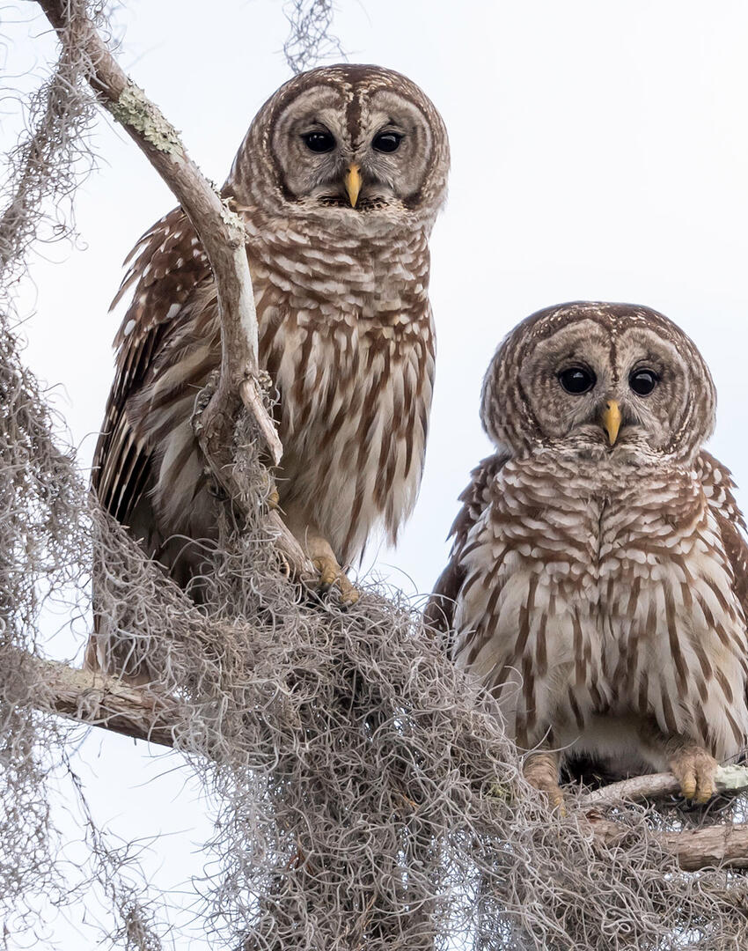
How should we protect declining species?
Part of the problem with the spotted owl case was limited information about the owls prior to their listing.
We need some information about habitat use prior to developing management plans
Today Spotted Owl populations continue to decline and Barred Owl ranges begin to impede on Spotted Owl habitat

Slide 12

Barred Owl removing Spotted Owl Video
Notes:
https://www.youtube.com/watch?v=YGFPsgQzeds

Slide 13
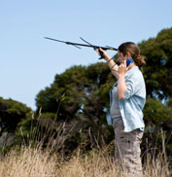
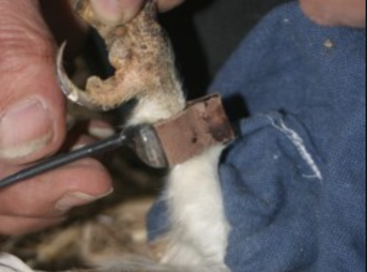
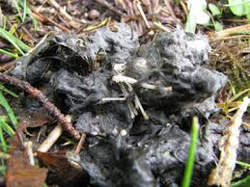
How do scientists determine home range size or territory?
Telemetry
Satellite tags tied to feathers, attached to the legs, or implanted surgically
Diet and behavior
Food availability, nesting or den sites, marked territory
This method is also useful for determining the ranges of prey species

Slide 14
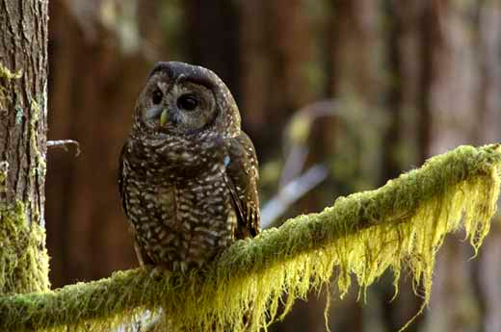
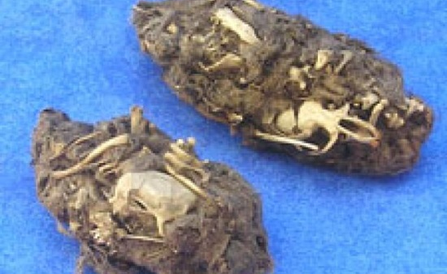
Part 1: Owl Pellets
What is an owl pellet?
How often are owl pellets produced by owls?
How might owl pellets inform scientists about ecosystems?
Note: pellets have been autoclaved and are sterile – but wear gloves and wash hands
Notes:
Owl pellets are kind of like hair balls, they are undigested food that is regurgitated by the owl. Our are autoclaved (sterilized). They include evidence of what the owl ate since it last produce a pellet. Owl pellets are produced 2 times per day.
Explain what owl pellets are and provide information on owl species in the local area (or other source of pellets). NOTE That these are Barn owl pellets that were purchased for the lab. NOT spotted owl pellets.
We can use owl pellets to learn about diet, food chains, home range size,
?? We can identify precisely what the bird has been feeding on. This is difficult enough with any bird,
especially with a night hunter like an owl.
?? We can get clues to the owl’s hunting habits from the prey it has taken.
?? We can estimate the numbers of different kinds of prey it takes.
?? If we find out more about the the prey animals, we learn a great deal about food chains and the
exact part the owl plays in them.
?? We can get a great deal of information about the different small mammals and where they are found.
This kind of information would otherwise be very difficult to discover.
http://www.rspb.org.uk/Images/Owlpellets_tcm9-133500.pdf

Slide 15
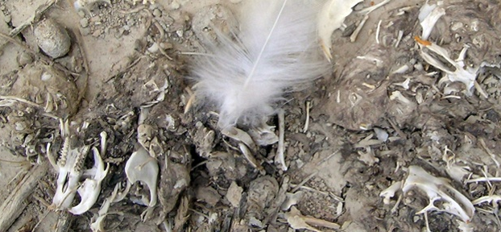
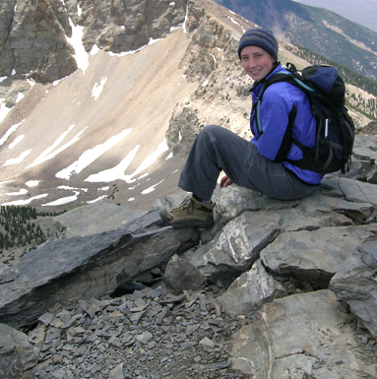
Owl Pellets at OSU
The Terry Lab
Notes:
Rebecca Terry in the Dept of integrative biology uses owl pellets to study climate change and changes in vertebrate assemblages over time. They can actually use date out pellets that have been preserved to provide a historical time line that informs modern day assemblages (David can you elaborate here?) From the website “We combine modern, historical, and fossil death-assemblages with modern and historical biodiversity surveys to reconstruct how terrestrial vertebrate species and their communities have changed through time. ”
Several TIS are working in her lab and several Tas as well We will be dissecting her pellets today!

Slide 16
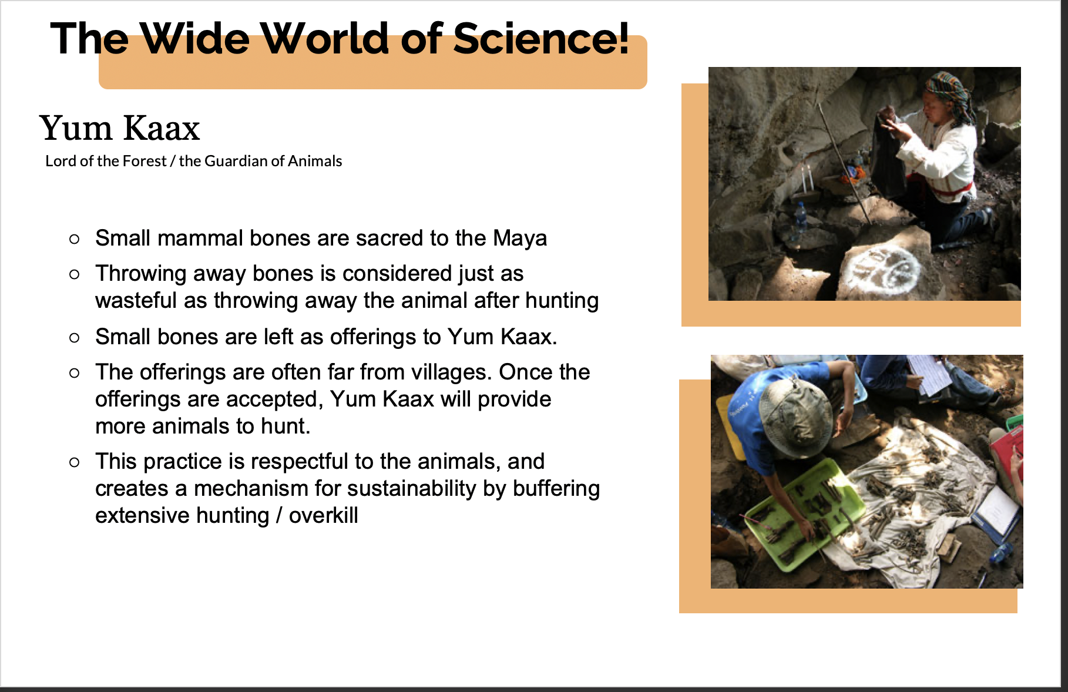

Slide 17

Estimation and Assumption in Science
In order to use owl pellets in research we have to make some assumptions and estimations.
You will be asked to think about this throughout the lab. Remember that in this lab you are the scientists, and you need to figure out how to get from the information in the owl pellet to owl home range size.
Notes:
Challenge students to think about when estimation and assumptions may be used and discuss the differences between guesses and predictions that can be defended using evidence and critical reasoning.

Slide 18
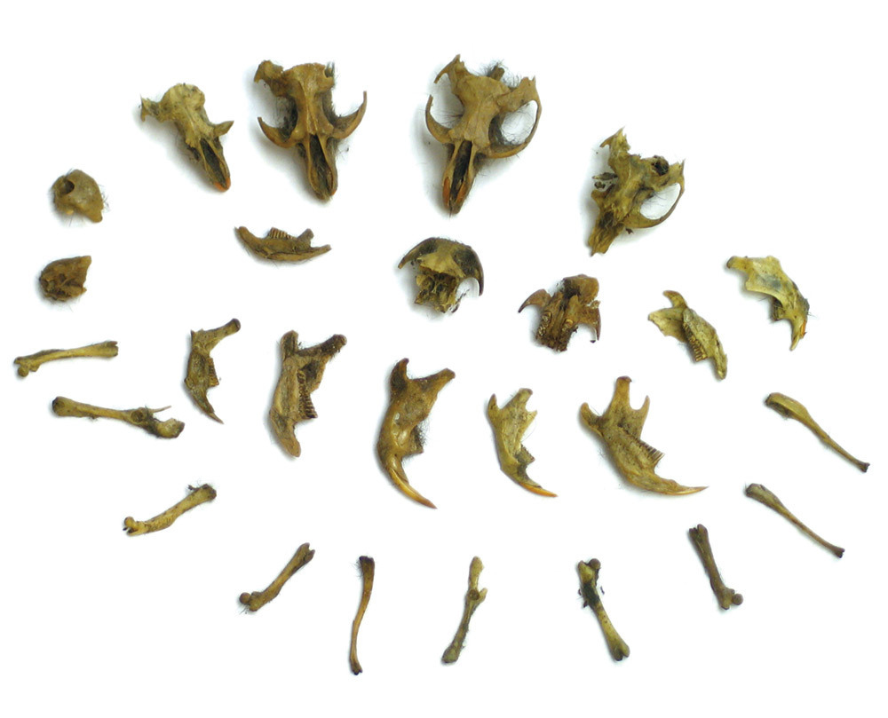
Calculate % of diet of each species found
Find mass of each species in diet by multiplying # individuals found with the average mass of that species.
To get the total mass of the diet, add up each of the individual masses in the diet.
To get each species’ % of mass, take the individual amount of mass divided by the total amount of mass.
2 field voles found * 40 g average mass per vole = 80 g
80 g field voles + 220 g water vole + 5 g mouse = 305 g
80 g field voles / 305 g total diet mass = field voles 26.2% of diet

Slide 19
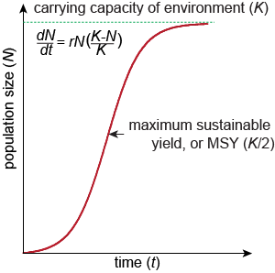
To determine maximum sustainable yield:
multiply the number of individuals per pellet by number of pellets per day and days per year.
e.g. if there are 2 field voles in your pellet
MSY= 2 voles/pellet * 2 pellets/day * 365 day/year
= 1460 voles/year

Slide 20
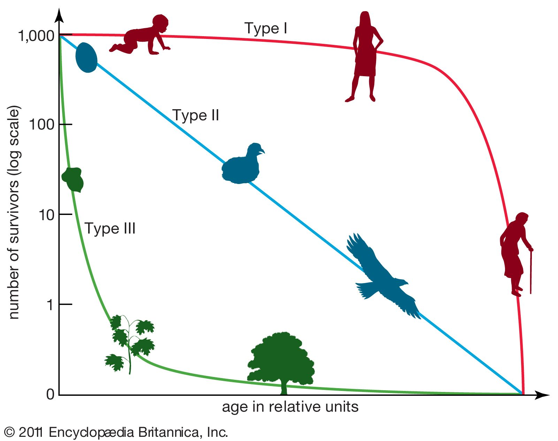
Part II: Small mammal life table
Complete life table and determine survivorship curve from mortality rates
To find the number of offspring in table 9-3 (page 116) divide current population (survivors) by two (estimated number of females) and multiply that by the number of offspring expected to be produced.
eg survivors = 375 and # of offspring = 4 per litter and 2 litters per year
375 /2 = 187.5 females
187.5 * 4*2 = 1500 offspring produced by cohort

Slide 21
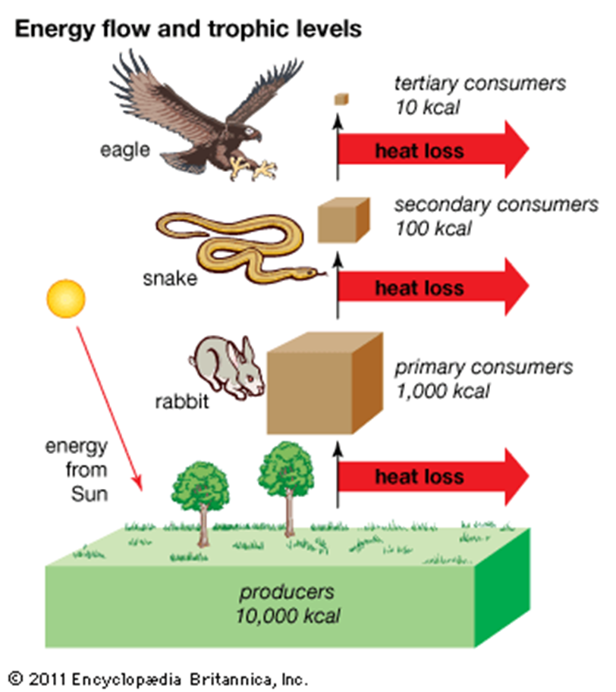
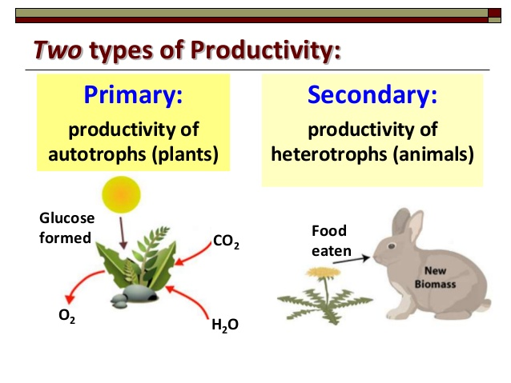
How does energy transfer within an ecosystem?
Notes:
If students are unfamiliar with the concept of productivity, discuss primary and secondary productivity and the loss of energy through trophic levels.

Slide 22

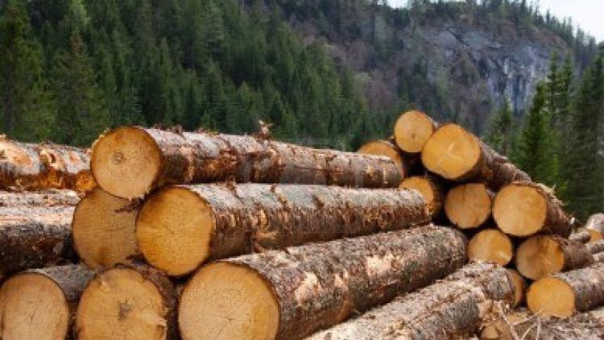
Parts 3 and 4:
Information on the small mammals and owls is at http://eol.org/ or provided in a table on your tray
For more about our case study check out Timber Wars by Oregon Public Broadcast
Also, there is lots of the spotted owl information is in your prelab article
Calculate area on the map using the grid

Slide 23
Today’s Tips and Tricks:
Working with owl pellets:
Each table gets one pellet. Break the owl pellet up and have each person work on part of the pellet to speed things up.
Bones are friable and easily broken so be careful
Information on the small mammals and owls is at http://eol.org/ or provided in a table on your tray to ID prey species
Like in other labs, don’t spend too much time worrying about the exact species, an estimate is fine (mole, vole, mouse etc.)
use % of diet to determine:
maximum sustainable yield
growth rate/type
prey density
owl territory size
Calculate area on the map using the grid – look at all 3 maps

Slide 24
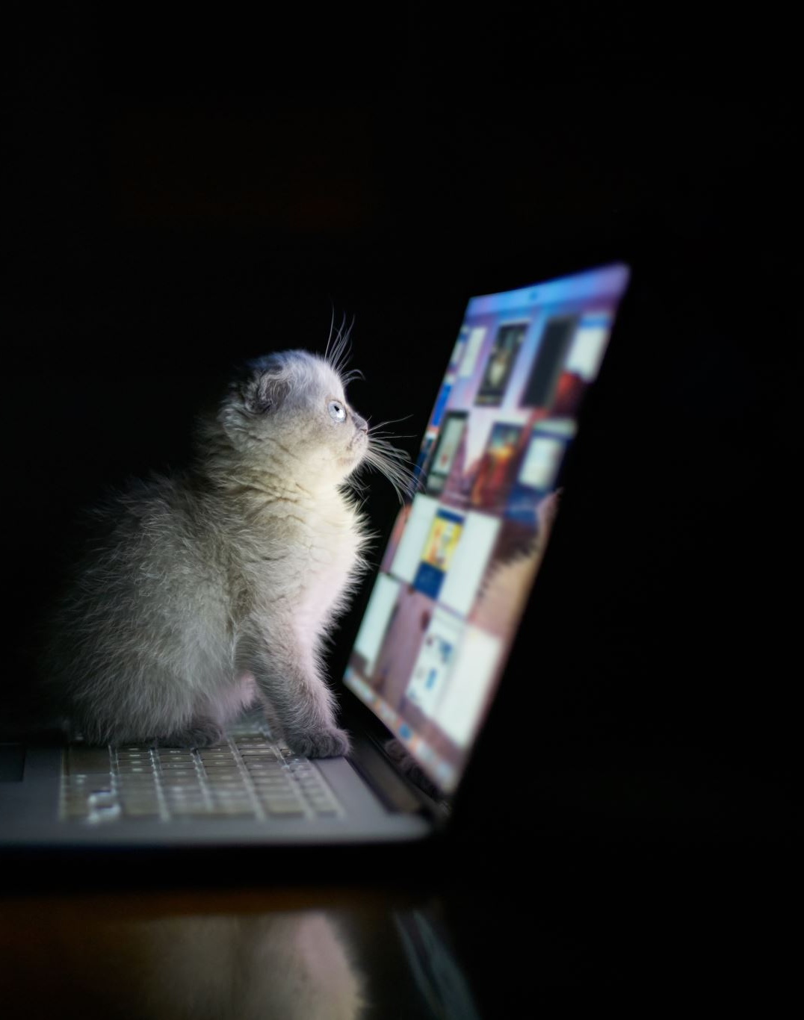
Clean up
Log out of the computer
Dispose of your owl pellet bone, detritus, and foil in the garbage.
Put all items back in the tray and wipe down the table and microscope as needed.
Wash your hands

